Slide 1
GRNFanzone

Slide 2
About Us

Slide 3
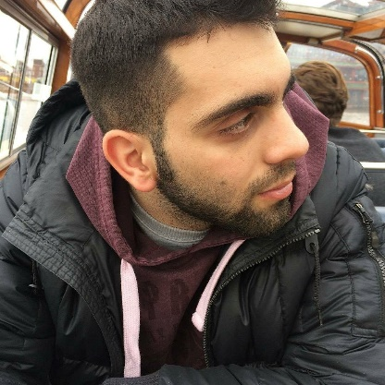
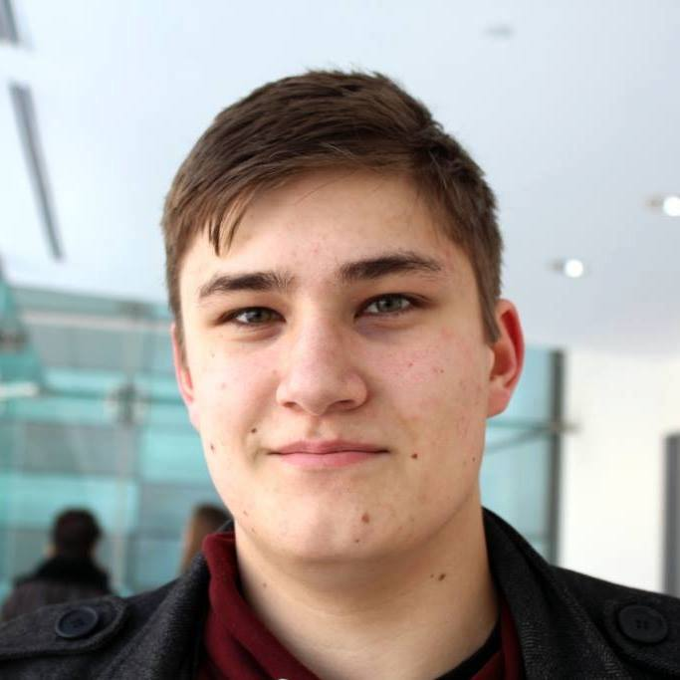

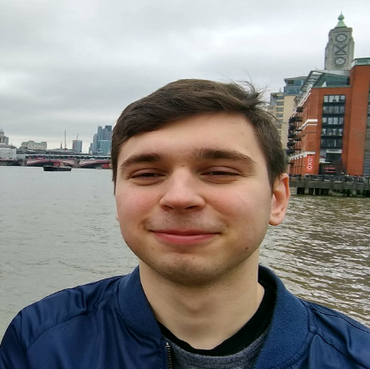
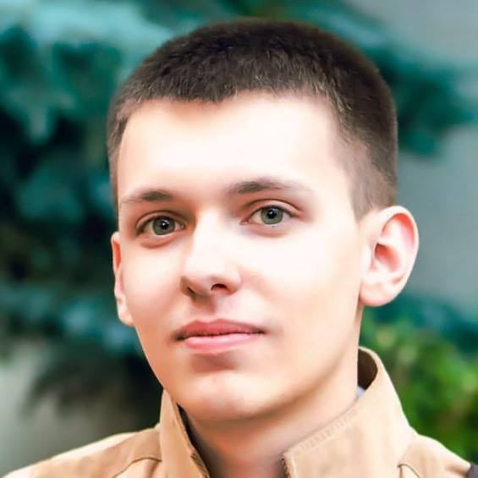
TEAM V
Marios Constantinou
Andrew McCluskey
Ruxandra Bob
Arnas Kapustinskas
Daniel Juranec

Slide 4

OUR CLIENTS
04
Global Rugby Network
GRN
GLOBAL RUGBY NETWORK
Global Rugby Network is a free team management platform
Aims to provide support to coaches and develop healthier, stronger teams
7 members, all played rugby on both professional and semi-professional teams.
Dave Millard, founder and CEO
Stefan, CTO
Cham, Lead Software Engineer

Slide 5

PROJECT MOTIVATION
04
FanZone – An Online Rugby Platform
Developed as a Web Application
Aims to provide users a way of interacting with their favourite rugby teams, clubs or even players
Target audiences:
Profile-Owners
Profile-followers.
Generate additional engagement with potential supporters, followers or sponsors
Up to date, and live updates on favourite teams, clubs, players, results, event

Slide 6







KEY FEATURES
Social Authentication
Searching
Follow/Unfollow
Marketing
Fixtures
Dashboard
Profiles

Slide 7




KEY TECHNOLOGIES USED
Bootstrap
Firebase
Research
Marketing
Angular 2
Gitlab

Slide 8
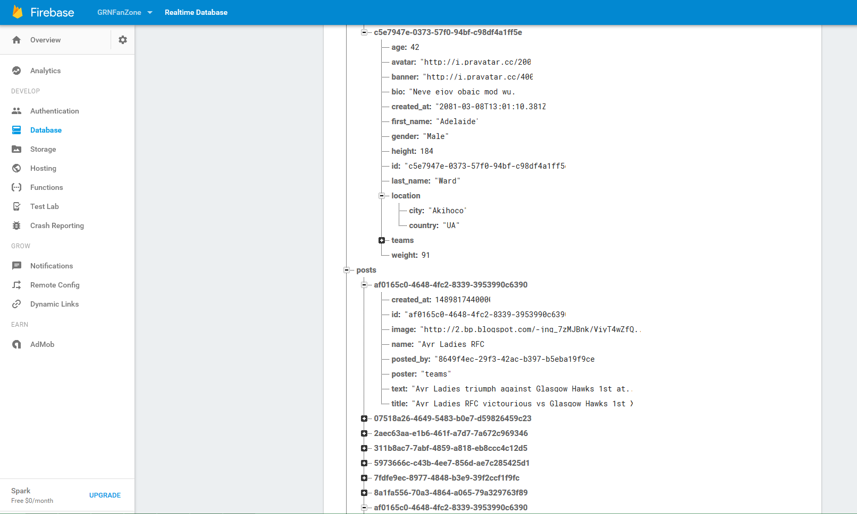
Firebase

Slide 9
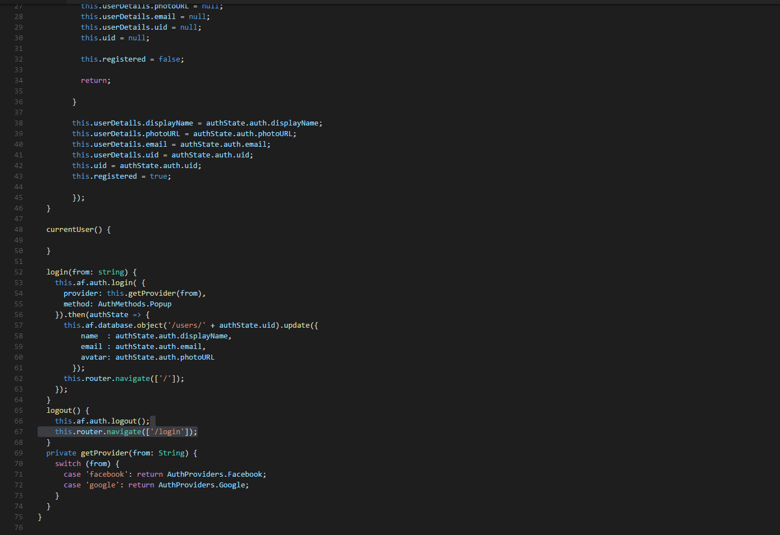
Angular2

Slide 10
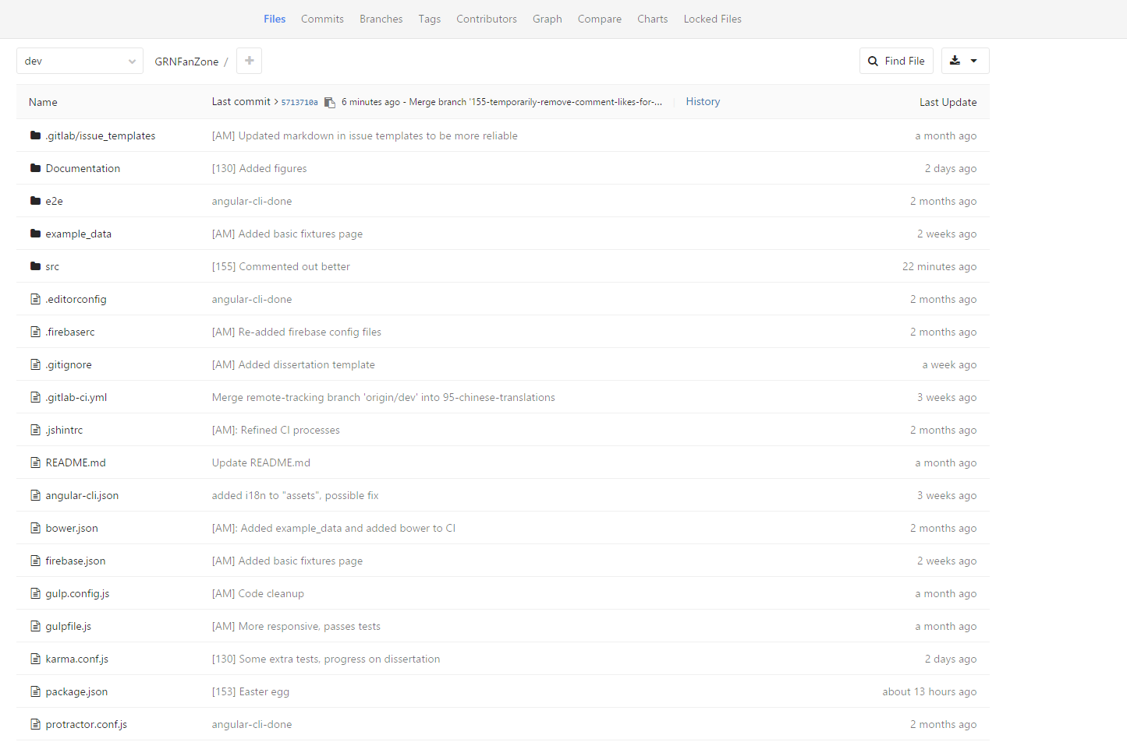
Gitlab

Slide 11
TECHNICAL FEATURES/CHALLENGES
Gitlab
Testing
TypeScript
Angular 2
Angular Fire
Bootstrap 4
Firebase
Bootstrap 3

Slide 12

Demo

Slide 13
FUTURE PLANS
Efficiency
Features
Searching
Dashboard
Redundant code
Media Posts
Event Pages
Personal Inbox

